Slide 1

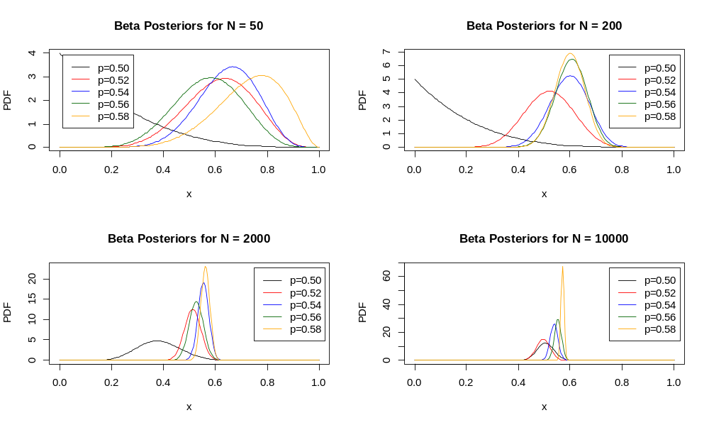
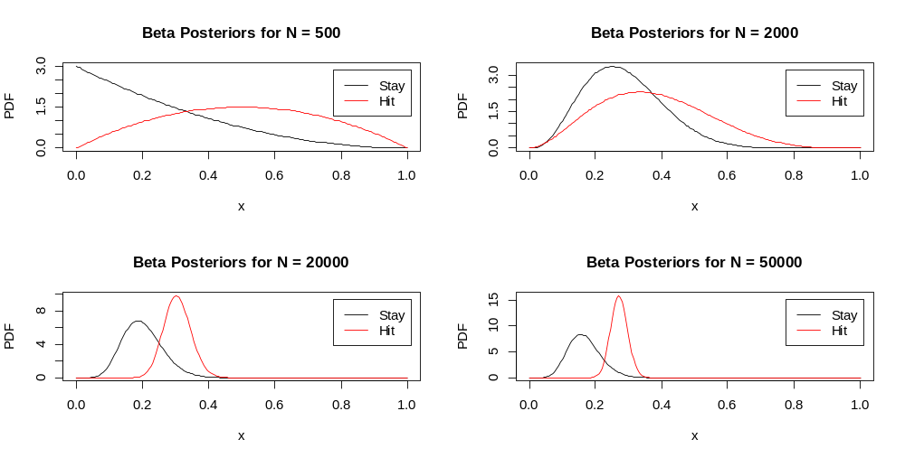
Evaluation of Bayesian Reinforcement Learning Techniques as Applied to Multi-Armed Bandit and Blackjack Problems
Robert Sawyer, Shawn Harris
ABSTRACT
BLACKJACK LEARNING
RESULTS
In reinforcement learning (RL), an agent interacts within an environment, periodically receiving rewards. The agent knows its current state in the environment and which actions it is allowed to take from that state. The agent aims to learn an optimal policy, or mapping from states to actions, to maximize the discounted future rewards received from the environment. RL methods aim to convert the agent’s experiences with the environment into an optimal policy [1], which can then be followed by the agent to maximize its rewards in the environment. When an agent follows its optimal policy, the agent is said to be exploiting the environment. Conversely, an agent is exploring the environment when it takes actions it does not believe to be optimal in order to learn more about the environment. The agent must balance this tradeoff between exploration and exploitation to maximize its overall reward while ensuring it is not missing better action trajectories through the environment.. This poster will present how reinforcement learning techniques can be used for resolving Multi-Armed Bandit (MAB) problems and for learning strategies in Blackjack..
In the game of blackjack, the object is to reach a final score higher than the dealer without exceeding 21, or to let the dealer draw additional cards in the hopes that his or her hand will exceed 21. The Bayesian strategy here is similar to the Multi-Armed Bandit problem, except that rather than selecting which arm to use, the choice is whether to take an additional card or to stay at the current total. Thus, a decision is based on the posterior reward probabilities for each possible state, which in this case is the combination of the player’s total and what card the dealer is showing. This is further complicated by the rule that an ace can be either 1 or 11…
Another difference in the learning algorithm for blackjack vs. MAB is that the reward in blackjack is not immediate. There could be two or three stay/hold decisions in a single game, so the reward could be applied to all of them or possibly a subset of them in order to minimize the learning time.
Given that there are 9 possible card totals that could require a stay/hit decision and 10 possible cards shown by the dealer, there would be 90 possible states that would each require it’s own stay/hit parameters for the beta distribution. When you add in the possibility the player holding a “soft ace” (one that could be counted as either 1 or 11), the number of possible states jumps to 180. The optimal blackjack strategy is fully developed when there is a clear choice at each possible state. Figure XX shows the changing distributions for one particular state (dealer is showing 9, player total is 15 without a soft ace) over time.
xxxxx
Figure 1: Posterior Beta Distributions for MAB Problem.
MULTI-ARMED BANDIT
In a Multi-Armed Bandit (MAB) problem, the agent must learn which of K slot machines (bandits) gives a binary reward at the highest rate. A good strategy for maximizing the total reward must involve some combination of exploration (finding the best machine) and exploitation (using the machine that appears to have the best payout).
One strategy for the MAB problem is a method known as epsilon-greedy. This method randomly alternates between exploration and exploitation modes based on the value of epsilon. So for example if a fixed value of 0.2 was used for epsilon, the method would randomly select a machine about 20% of the time, and would select the best-paying machine (based on current knowledge) about 80% of the time. The problem with a fixed epsilon value, however, is that there is no need for exploration once the best-paying machines are identified. Therefore, an improved epsilon-greedy algorithm using an exponentially decaying epsilon value so that the amount of exploration decreases over time.
[SHOW EPSILON DECAY FORMULA HERE?? OR MAYBE A DIAGRAM??]
A Bayesian learning algorithm for the MAB problem uses a prior beta distribution for the probability of each machine returning a reward. As the machine gets used, the binomial data collected is used to calculate new beta posterior distributions at each cycle. Random sampling from these posterior distributions is used to decide which machine to play next. Over time, the variability in the posteriors decreases and the machine with the best reward probability is selected more often. This is shown in Figure 1. The true reward probabilities are shown in the legend.
METHOD COMPARISON
CONCLUSIONS
To compare results from the epsilon-greedy method to the Bayesian method, a series of tests were simulate using various ranges of true reward probabilities. In most cases, the two methods performed similarly, with some differences…
Bayesian Reinforcement Learning did not show itself to be significantly better than the Epsilon-greedy method in the case of the Multi-Armed Bandit problem. However, it seems that there are certain problems where a Bayesian approach would be clearly preferred, such as…
Figure 3: Change in Blackjack Posterior Distributions over Time.
REFERENCES
Figure 2: Distribution of difference in total reward between epsilon-greedy and Bayesian methods.
More text here…
[1] Sutton, Richard S., and Andrew G. Barto. Reinforcement learning: An introduction. Vol. 1. No. 1. Cambridge: MIT press, 1998.
[2] Ghavamzadeh, Mohammad, et al. "Bayesian reinforcement learning: A survey." Foundations and Trends® in Machine Learning 8.5-6 (2015): 359-483.

